Slide 1

Work Integrated Learning
By: Nathaniel Tshabalala

Slide 2
Table of Content
Overview
Website Wireframe
Website Design
Website Functionality
Application Wireframe
Application Design
Application Functionality
Conclusion

Slide 3
Empower The Nation

Slide 4
Overview:
Initiative by Precious Radebe: Aimed at providing skills training for domestic workers and gardeners, supporting those who were historically denied upskilling opportunities.

Slide 5
Website Wireframe
Design process

Slide 6

Logo
Handheld torch: Symbolizes knowledge, understanding, and insight.
Orange: Symbolizes spark and ignition, representing the spark of empowerment.
Black: Represents solidity and stability, grounding the empowerment movement.
Provides contrast, making the orange torch flame stand out.

Slide 7
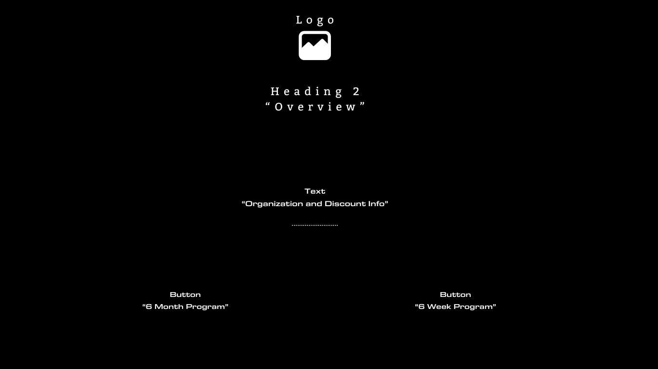
Landing page
Brief Overview of the organisation.
Discount Information of courses.
Buttons for fluid navigation across the website

Slide 8
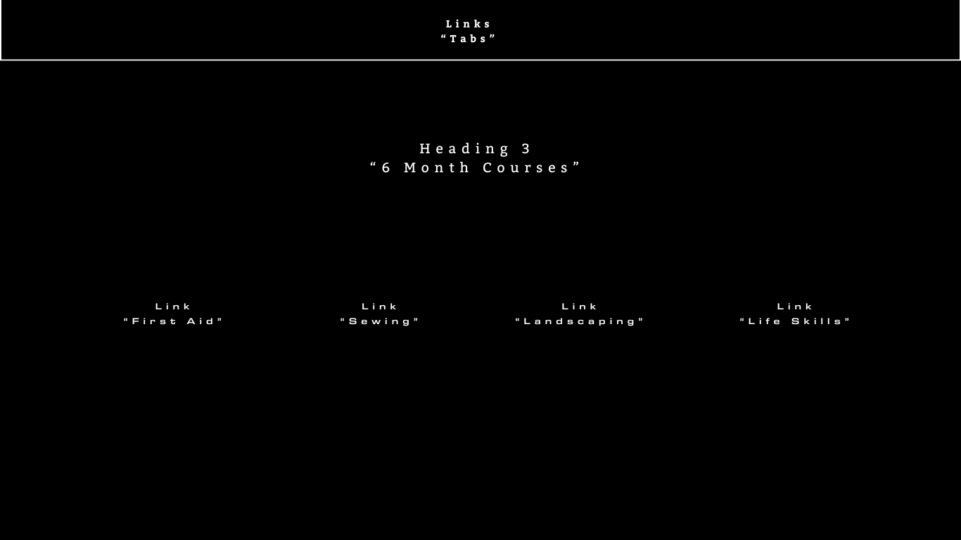
6m Course Page
Links to different course pages.
Each with their corresponding course details.

Slide 9
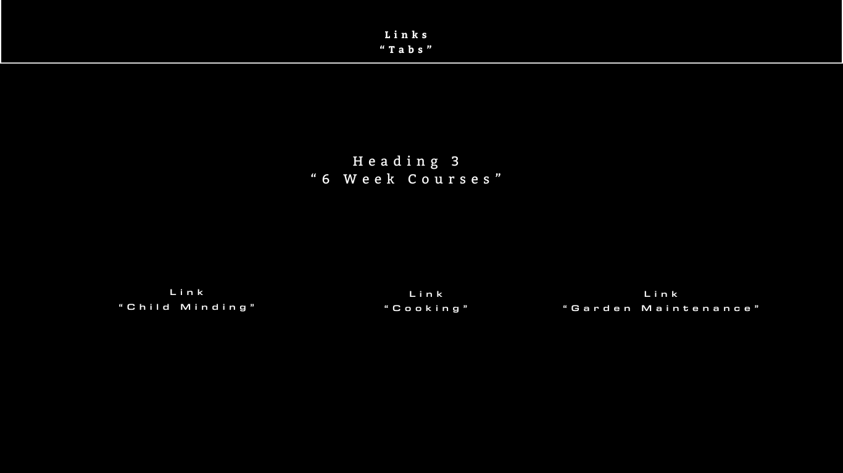
6w Course page
Links to different course pages.
Each with their corresponding course details.

Slide 10
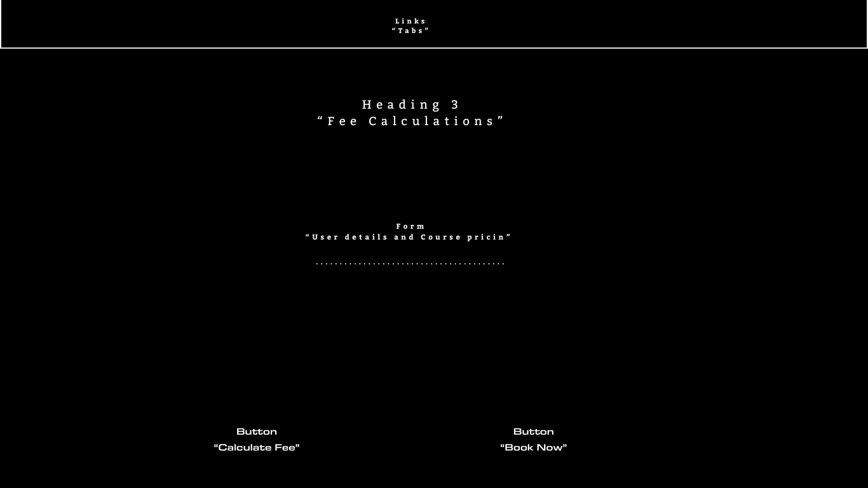
Payment page
Form Field for user details
Checklist of courses available
Button for Fee calculation with discounts in mind

Slide 11
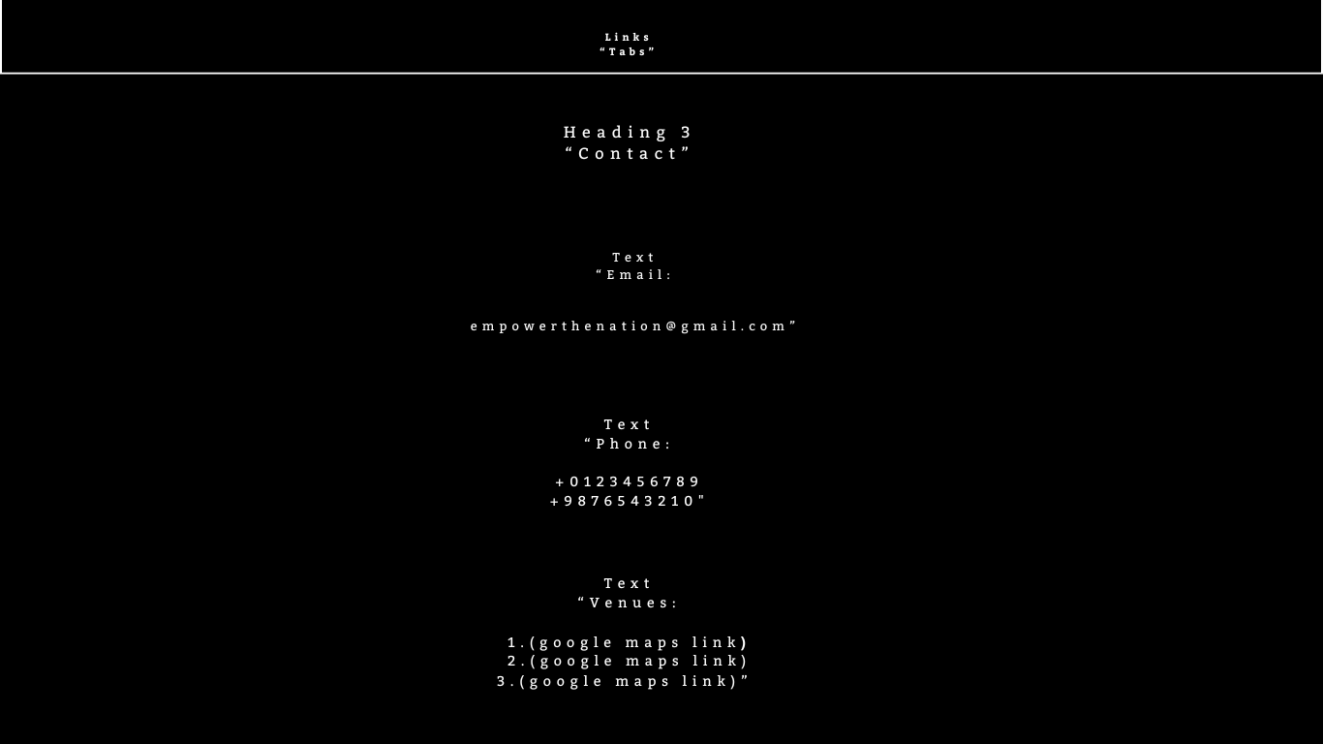
Contact page
Form Field for user details
Checklist of courses available
Button for Fee calculation with discounts in mind

Slide 12
Website Design
Screenshots

Slide 13
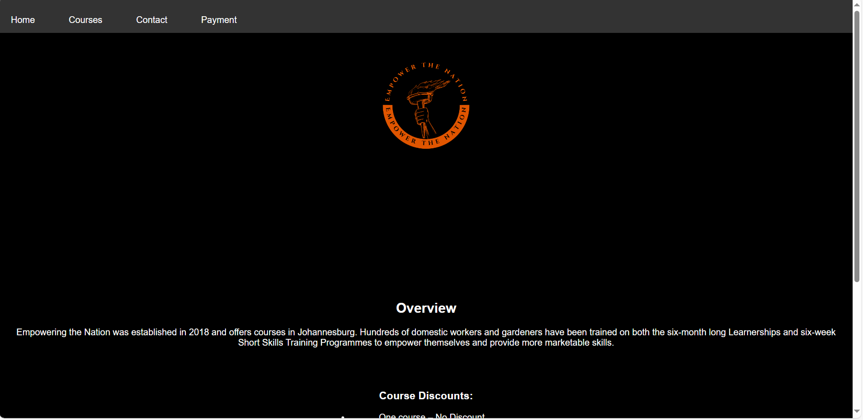
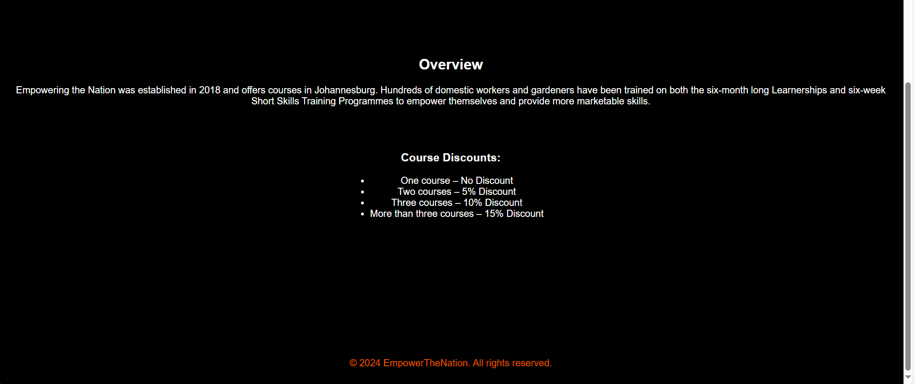
Landing page
Brief Overview of the organisation.
Discount Information of courses.
Navigation bar for fluid navigation across the website

Slide 14
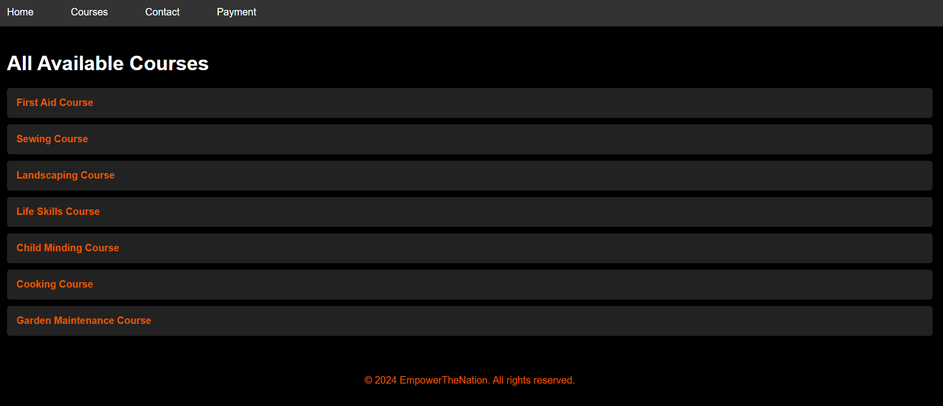
Available courses page
Links to different course pages.
Each with their corresponding course details.

Slide 15
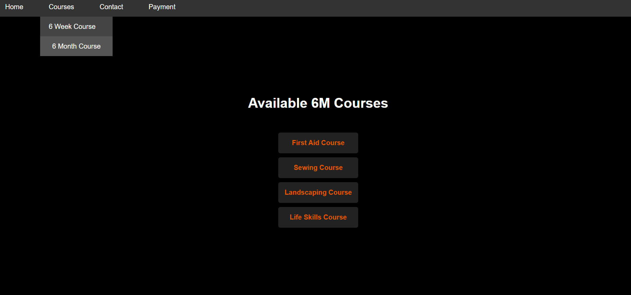
6m courses page
Links to different course pages.
Each with their corresponding course details.

Slide 16

6w courses page
Links to different course pages.
Each with their corresponding course details.

Slide 17
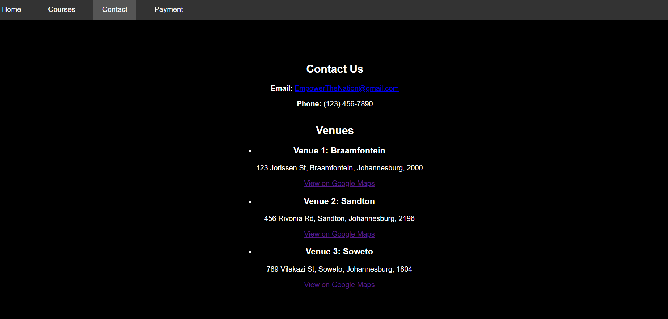
Contact page
Email, Phone No.
Map links of Venues

Slide 18
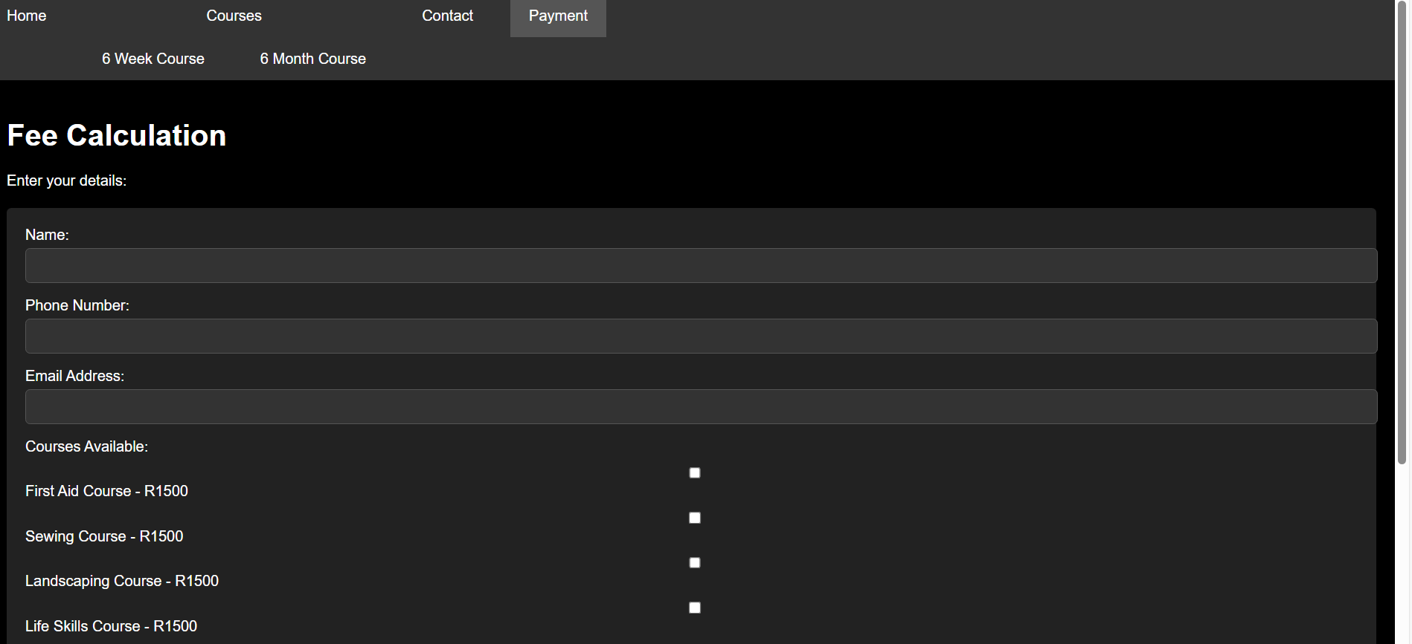
Fee calculation page
Form Field for user details
Checklist of courses available
Button for Fee calculation with discounts in mind

Slide 19
DEMONSTRATION

Slide 20
Application Wireframe
Design Process

Slide 21
Logo
Handheld torch: Symbolizes knowledge, understanding, and insight.
Orange: Symbolizes spark and ignition, representing the spark of empowerment.
Black: Represents solidity and stability, grounding the empowerment movement.
Provides contrast, making the orange torch flame stand out.

Slide 22
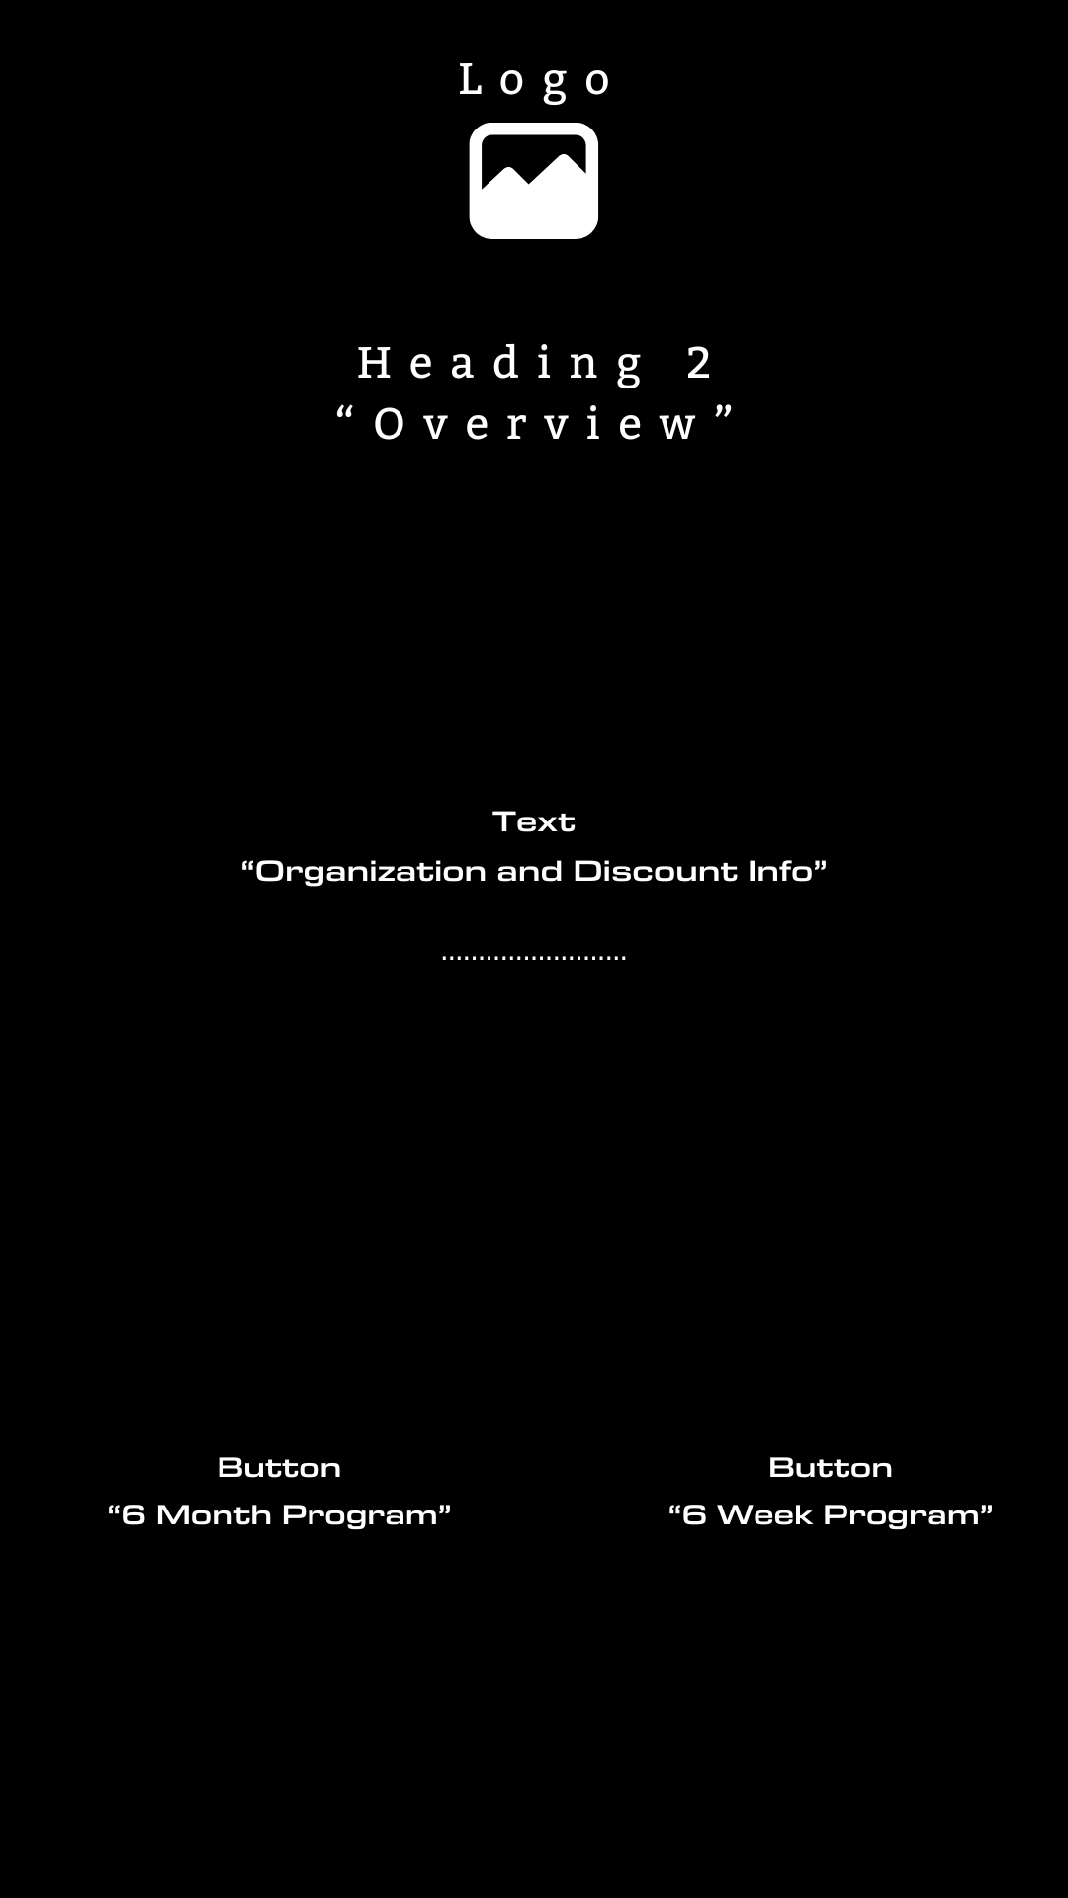
Homepage
Brief Overview of the organisation.
Information of courses.
Buttons for fluid navigation across the application.

Slide 23
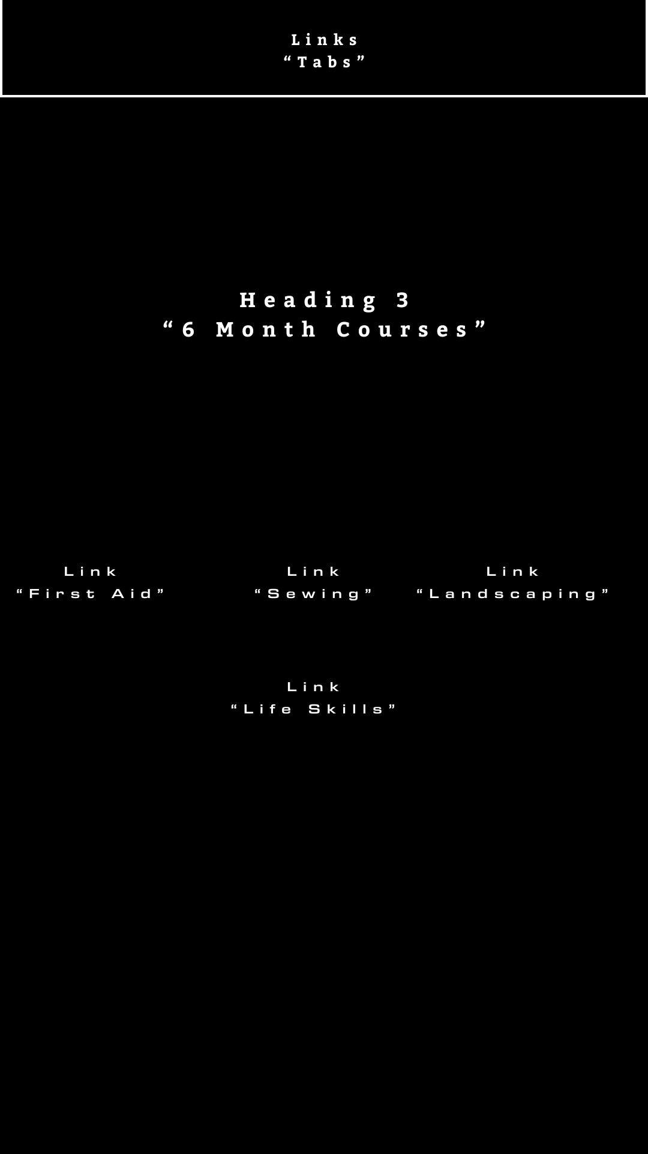
6m course page
Links to different course pages.
Each with their corresponding course details.

Slide 24
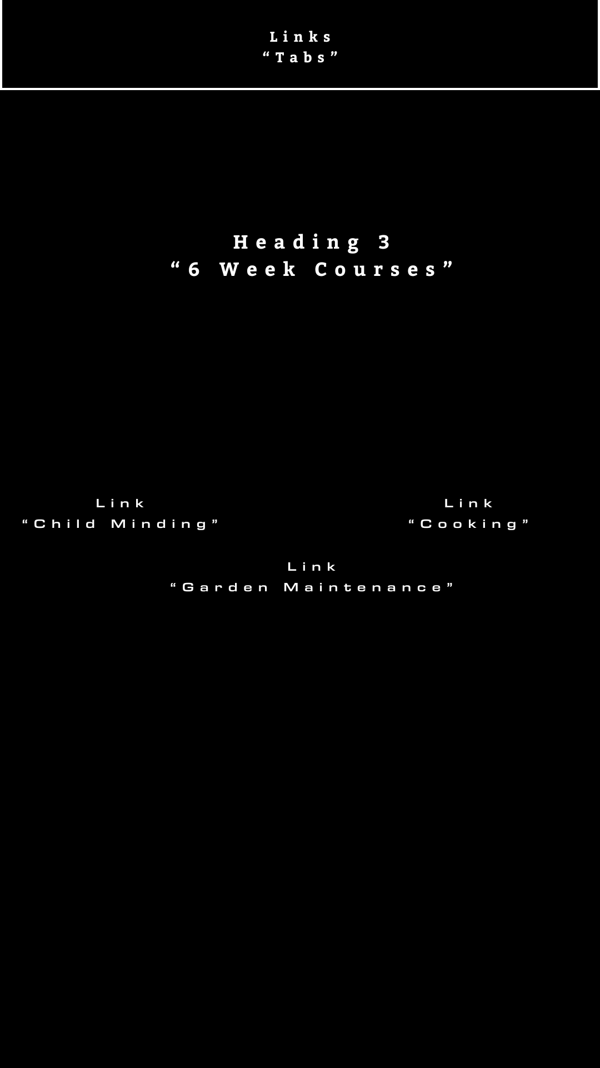
6w course page
Links to different course pages.
Each with their corresponding course details.

Slide 25
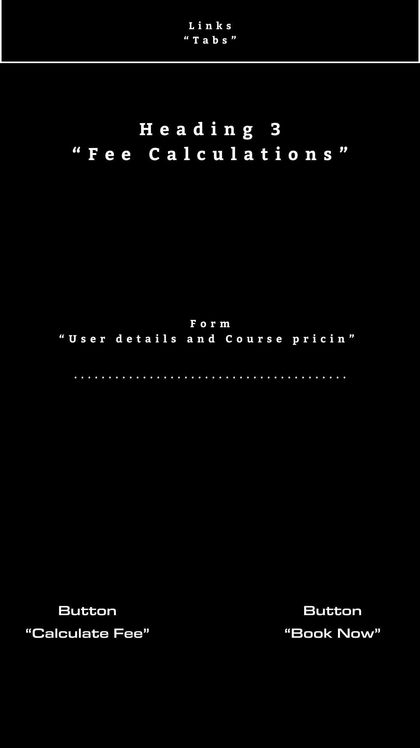
Fee calculation page
Form Field for user details
Checklist of courses available
Button for Fee calculation with discounts in mind

Slide 26
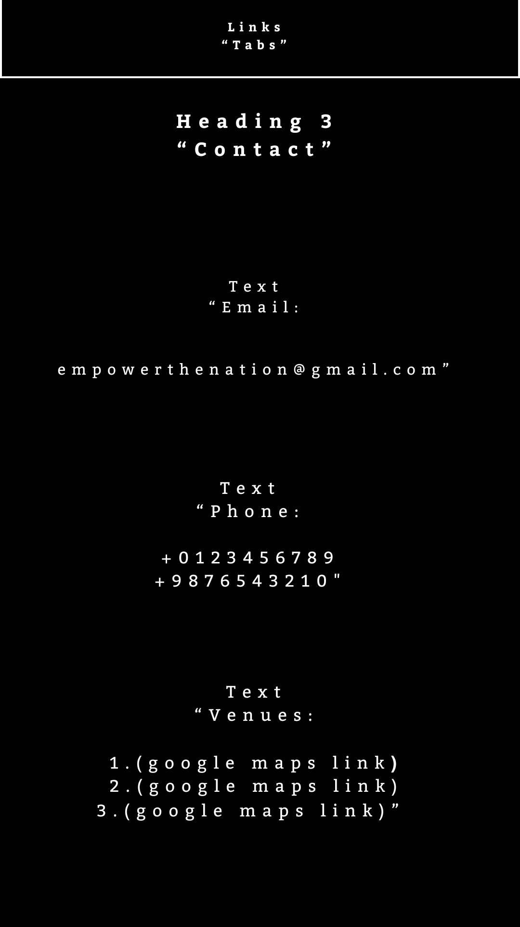
Contact page
Email, Phone No.
Map View of Venues

Slide 27
Application Design
Screenshots

Slide 28
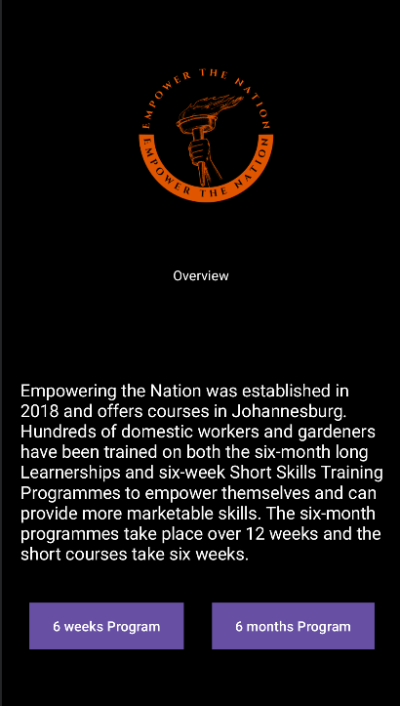
Landing page
Brief Overview of the organisation.
Information of courses.
Buttons for fluid navigation across the
Application.

Slide 29
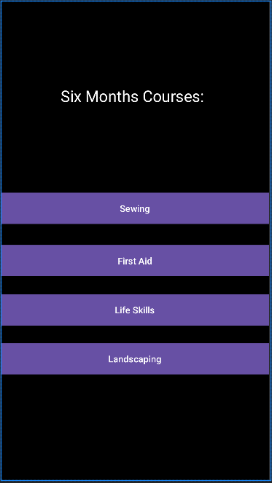
6 months course page
Links to different course pages.
Each with their corresponding course details.

Slide 30
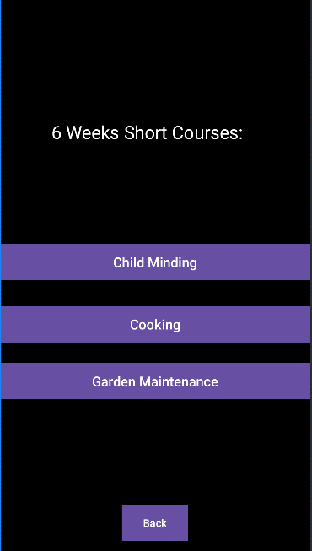
6 week Course page
Links to different course pages.
Each with their corresponding course details.

Slide 31
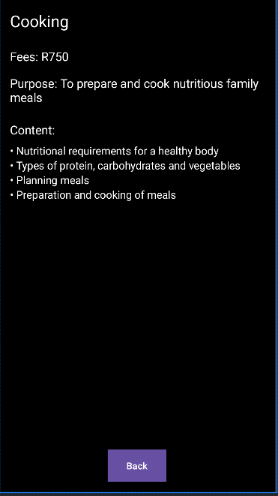
6w course example
Details of relative course.

Slide 32
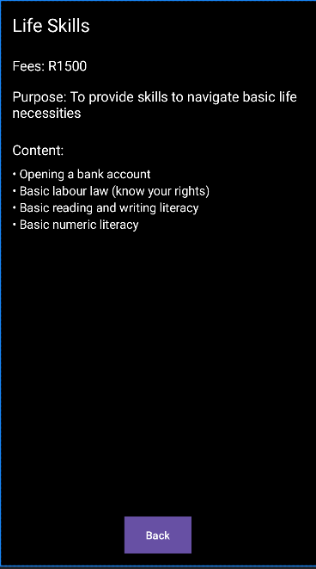
6M Course example
Details of relative course.

Slide 33
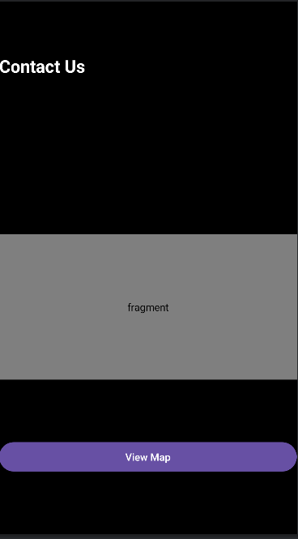
Contact page
Locations of different Venues

Slide 34
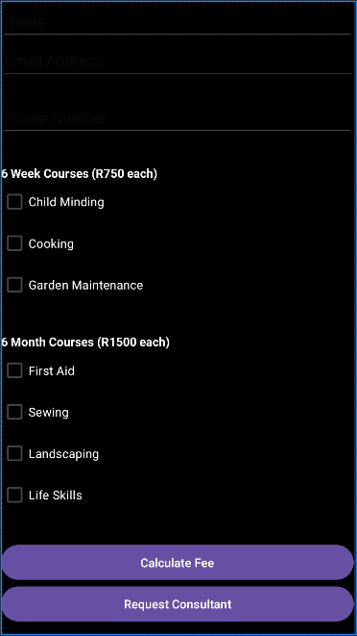
Fee Calculation
Form Field for user details
Checklist of courses available
Button for Fee calculation with discounts in mind

Slide 35
Demonstration

Slide 36
Conclusion:
In summary, "Empowering the Nation" represents a vital initiative aimed at uplifting individuals within the community through skills training. By developing a web page and mobile app, we will enhance visibility, facilitate communication with potential customers, and streamline the process of providing quotes for services.
Our design choices will reflect the professionalism and purpose of the organization, aligning with Precious Radebe’s vision to empower domestic workers and gardeners. Through this initiative, we not only create opportunities for personal and economic growth but also contribute to the overall betterment of the community.

Slide 37
THANK YOU

